Slide 1
Demystifying Kubernetes for Security Analytics
DATA. INSIGHTS. ANSWERS.

Slide 2
Table of Contents
Introduction 01
Logging in k8s 02
The Problem 03
Introduction
Kubernetes is an extremely powerful cloud platform but it lacks a native, centralized log storage & analysis backend. This makes analyzing your web app's logs for security threats difficult. Learn how to collect and analyze these logs with Fluentd and Graylog to strengthen your deployment's security posture!
Potential Solutions 04
Solution Overview 05
Demo 06

Slide 3

Overview
Demystifying Kubernetes for Security Analytics | The Problem

Slide 4
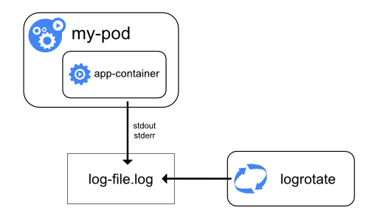
Logging in Kubernetes
Containers print app logs to stdout/stderr
Pods read container stdout/stderr
Pod logs accessed via k8s API (`kubectl logs`)
/var/log/pods/*.log
Demystifying Kubernetes for Security Analytics | The Problem

Slide 5
The Problem
Demystifying Kubernetes for Security Analytics | The Problem

Slide 6
Problems
No native cluster-level logging
No pod? No logs!
No app analytics
Manual log analysis is so 90’s, dawg…
Notes:
K8s is a distributed platform, not a SaaS offering, so there is no native centralized cluster-wide log store for k8s admins to monitor.
Since logs are only accessible via API, if the Pod is down you cannot see its logs anymore
There is the /var/log/pods directory though, but again you’re looking at individual pod’s logs, not a complete deployment overview
Because of this, there is no native way to do basic operational or security analytics on our k8s apps.

Slide 7
Potential Solution #1
Build log export directly into your application.
Too bespoke, different for every app
Expertise required
Changes to container images might break support
SECTION NAME

Slide 8
Potential Solution #2
Use host-level log aggregation (e.g. filebeat, syslog-ng)
Impossible with cloud-managed k8s
Increased host complexity
No deployment automation (unless you build it)
SECTION NAME

Slide 9
The BEST Solution!
Use a “sidecar” container that runs in all pods, aggregates all pod logs, and forwards to central log storage!
Auto-scales with Pod count (k8s DaemonSet)
Keeps containers & nodes idempotent
No pod? Still have logs!
“Single pane of glass” analysis across all apps
Demystifying Kubernetes for Security Analytics | The Problem

Slide 10
OK but How?
Demystifying Kubernetes for Security Analytics | The Problem

Slide 11

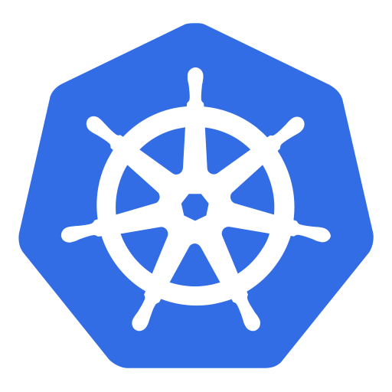


KuBirdLog at the helm, ‘n8s!

Slide 12
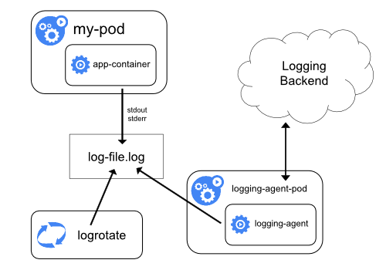
Blurry diagram? Blame the docs!

Slide 13
Solution Overview
Fluentd/Filebeat DaemonSet deployed to all pods, collects stdout/stderr from all apps via pod log files
Log collectors do basic formatting, outputs to Graylog (running outside k8s) in GELF (Fluentd) or JSON (Filebeat) format
Graylog normalizes and parses data further
Have a beer while monitoring your entire k8s cluster through a single pane of glass!
The real solution is the beer

Slide 14
Demo time!
SECTION NAME

Slide 15
THANK YOU.

